Slide 1
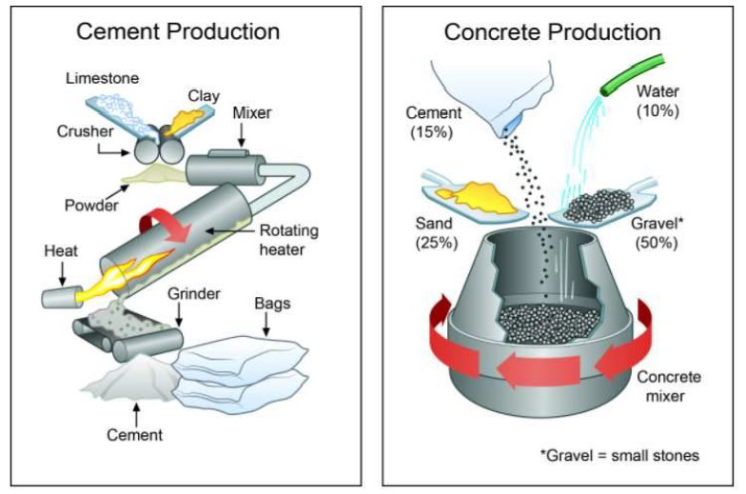
PROCESS DIAGRAM

Slide 2
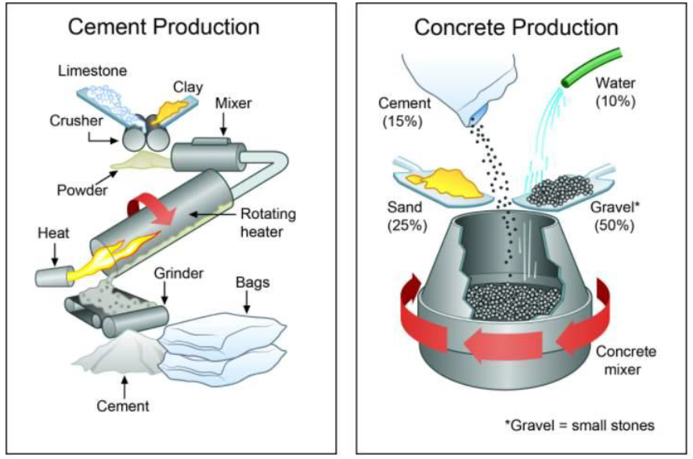

Slide 3
The diagrams below show the stages and equipment used in the cement-making process, and how cement is used to produce concrete for building purposes.
Summarise the information by selecting and reporting the main features, and make comparisons where relevant.
Write at least 150 words.

Slide 4
SAMPLE ANSWER
The diagrams show how cement and concrete are produced. Overall, there are five stages in the production of cement, while the procedure for producing concrete from cement and a few other simple ingredients involves a single stage.
Cement production begins when the initial raw materials, namely limestone and clay, are crushed using two crushers to make a fine powder which is then mixed in a cylindrical mixer. The next stage involves a tube-like rotating heater with a blowtorch showing at its bottom opening, from where fire is coming out to heat the powder. The mixed powder is fed from the top and heated, after which it is transferred to a grinder. There, it is reduced to fine particles by grinding to yield the final cement product which is eventually packed in bags.
The cement from the final production is used as raw material in the production of concrete in a second process. An initial mixture comprising 15% cement, 10% water, one-quarter sand and half gravel is fed into a rotating concrete mixer, where the ingredients are stirred until the concrete mix is ready for construction purposes.
(186 words)

Slide 5
Identify the Main Features
1) Is it a linear or a cyclical process?
A linear process starts and finishes at different places. It will often involve the manufacture or creation of something, starting with the raw materials going in at one end and the finished product coming out the other end.

Slide 6
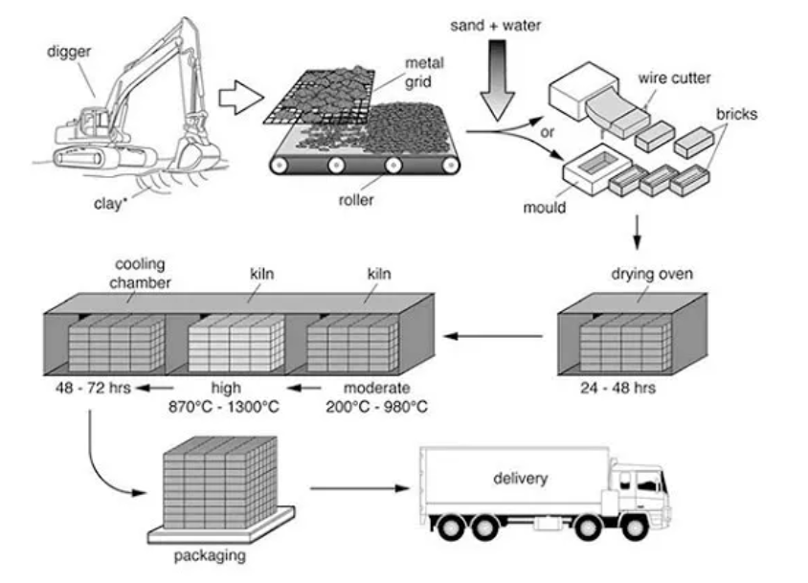
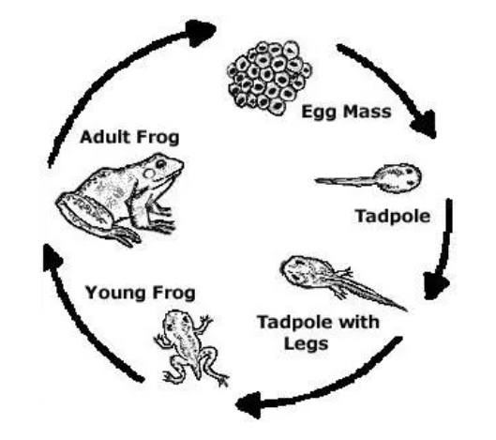
LINEAR
CYCLICAL

Slide 7
Identify the Main Features
2) Where does the process start and end?
For a linear process this will usually be obvious. It may be harder to determine for a cyclical process so it’s important that you examine the graphic carefully to find out.
3) How many steps are there to the process?
If there are a lot, it can be helpful to number them from 1 to whatever number the final stage is.

Slide 8
Identify the Main Features
4) Can the process be easily broken down into stages?
Stage 1: Cement Production-5 Stages
Stage 2: Concrete Production-1 Stage

Slide 9
Write an Introduction
Question:
The diagrams below show the stages and equipment used in the cement-making process, and how cement is used to produce concrete for building purposes.
Introduction (Paragraph 1):
The diagrams show how cement and concrete are produced.
DO NOT GIVE ANY HEADING
THE HEADINGS OF THE PARAGRAPHS ARE FOR EXPLANATION ONLY
YOUR WRITING SHOULD ONLY HAVE PARAGRAPHS AS SHOWN IN THE LAST SLIDE

Slide 10
Write an Overview
Stage 1: Cement Production
Stage 2: Concrete Production
Overview (Paragraph 1):
Overall, there are five stages in the production of cement, while the procedure for producing concrete from cement and a few other simple ingredients involves a single stage.
DO NOT GIVE ANY HEADING
THE HEADINGS OF THE PARAGRAPHS ARE FOR EXPLANATION ONLY
YOUR WRITING SHOULD ONLY HAVE PARAGRAPHS AS SHOWN IN THE LAST SLIDE

Slide 11
Paragraph-1 (Intro+Overview)
The diagrams show how cement and concrete are produced. Overall, there are five stages in the production of cement, while the procedure for producing concrete from cement and a few other simple ingredients involves a single stage.
DO NOT GIVE ANY HEADING
THE HEADINGS OF THE PARAGRAPHS ARE FOR EXPLANATION ONLY
YOUR WRITING SHOULD ONLY HAVE PARAGRAPHS AS SHOWN IN THE LAST SLIDE

Slide 12
Write the 1st Detail Paragraph
Stage 1: Cement Production
Paragraph 2:
Cement production begins when the initial raw materials, namely limestone and clay, are crushed using two crushers to make a fine powder which is then mixed in a cylindrical mixer. The next stage involves a tube-like rotating heater with a blowtorch showing at its bottom opening, from where fire is coming out to heat the powder. The mixed powder is fed from the top and heated, after which it is transferred to a grinder. There, it is reduced to fine particles by grinding to yield the final cement product which is eventually packed in bags.
DO NOT GIVE ANY HEADING
THE HEADINGS OF THE PARAGRAPHS ARE FOR EXPLANATION ONLY
YOUR WRITING SHOULD ONLY HAVE PARAGRAPHS AS SHOWN IN THE LAST SLIDE

Slide 13
Write the 2nd Detail Paragraph
Stage 2: Concrete Production
Paragraph 3:
The cement from the final production is used as raw material in the production of concrete in a second process. An initial mixture comprising 15% cement, 10% water, one-quarter sand and half gravel is fed into a rotating concrete mixer, where the ingredients are stirred until the concrete mix is ready for construction purposes.
DO NOT GIVE ANY HEADING
THE HEADINGS OF THE PARAGRAPHS ARE FOR EXPLANATION ONLY
YOUR WRITING SHOULD ONLY HAVE PARAGRAPHS AS SHOWN IN THE LAST SLIDE

Slide 14
SAMPLE ANSWER
The diagrams show how cement and concrete are produced. Overall, there are five stages in the production of cement, while the procedure for producing concrete from cement and a few other simple ingredients involves a single stage.
Cement production begins when the initial raw materials, namely limestone and clay, are crushed using two crushers to make a fine powder which is then mixed in a cylindrical mixer. The next stage involves a tube-like rotating heater with a blowtorch showing at its bottom opening, from where fire is coming out to heat the powder. The mixed powder is fed from the top and heated, after which it is transferred to a grinder. There, it is reduced to fine particles by grinding to yield the final cement product which is eventually packed in bags.
The cement from the final production is used as raw material in the production of concrete in a second process. An initial mixture comprising 15% cement, 10% water, one-quarter sand and half gravel is fed into a rotating concrete mixer, where the ingredients are stirred until the concrete mix is ready for construction purposes.
(186 words)

